Slide 1
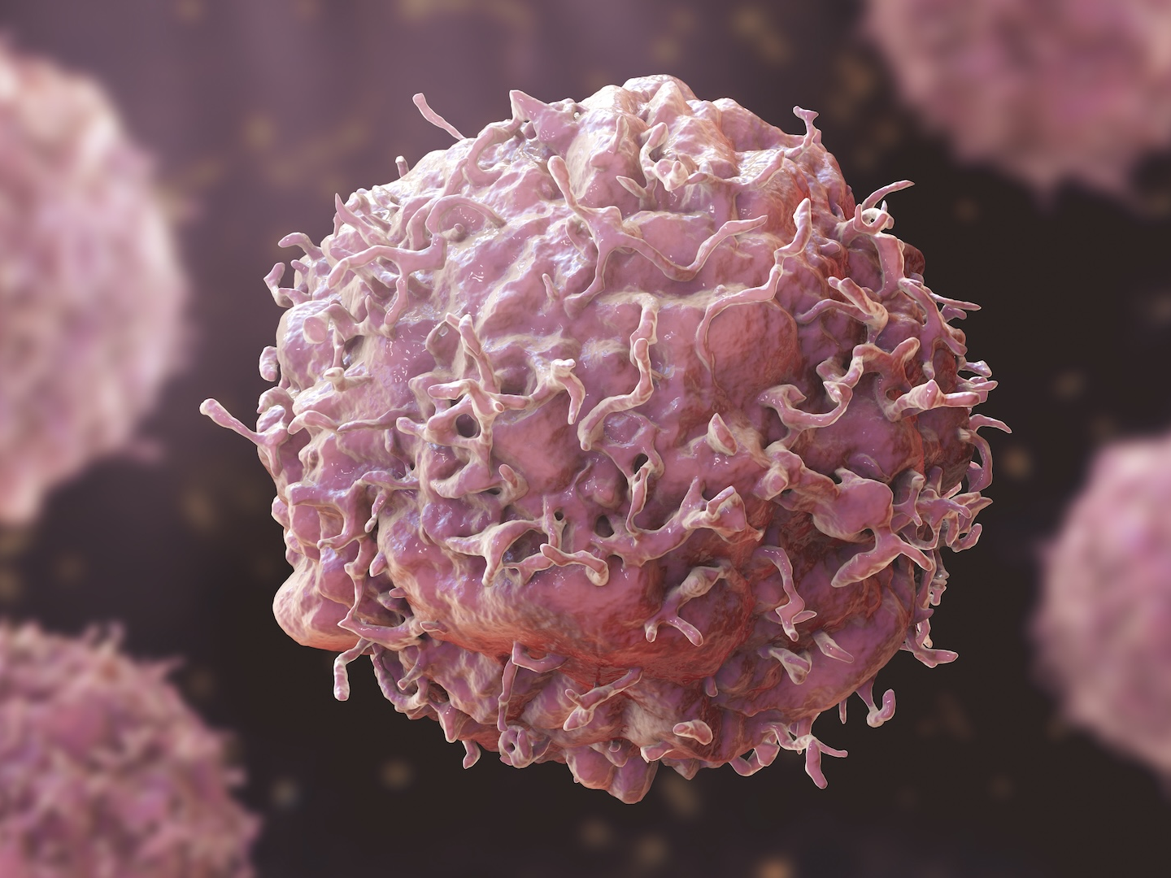
What Single-Cell Data Is Teaching Us About Cancer Evolution
From curiosity to cancer insight one cell at a time.

Slide 2
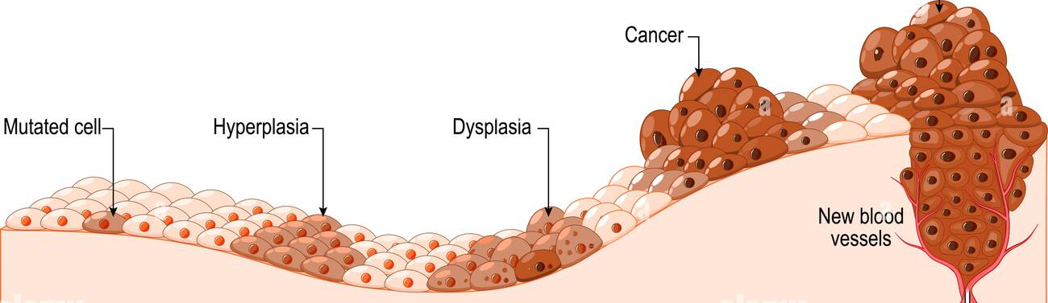
Cancer as an Evolving Ecosystem
Traditional sequencing saw cancer as uniform.
scRNA-seq reveals it as a dynamic ecosystem where tumour, immune, and stromal cells are constantly interacting and adapting.

Slide 3
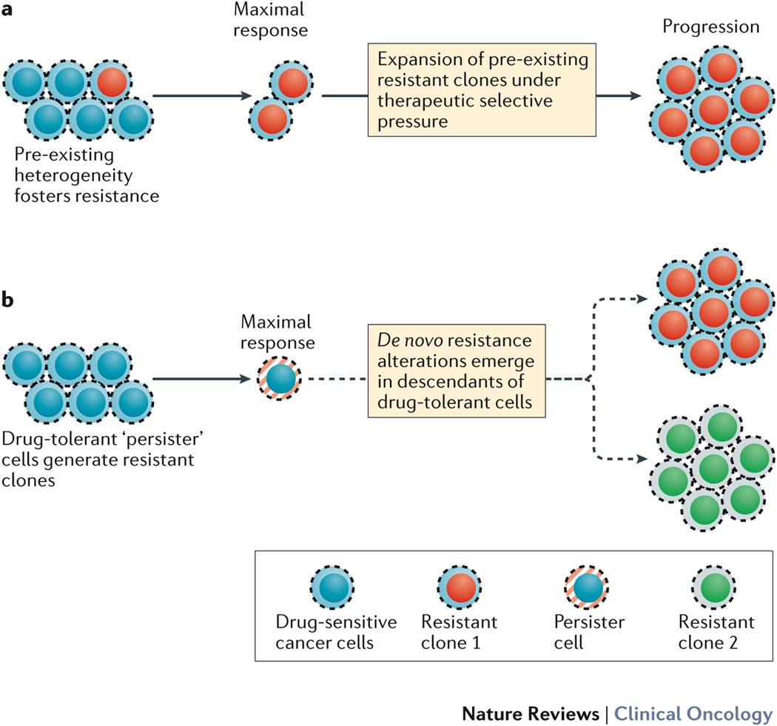
Mapping Heterogeneity and Resistance
scRNA-seq:
exposes hidden subpopulations within tumours.
identifies rare resistant cells that survive treatment

Slide 4
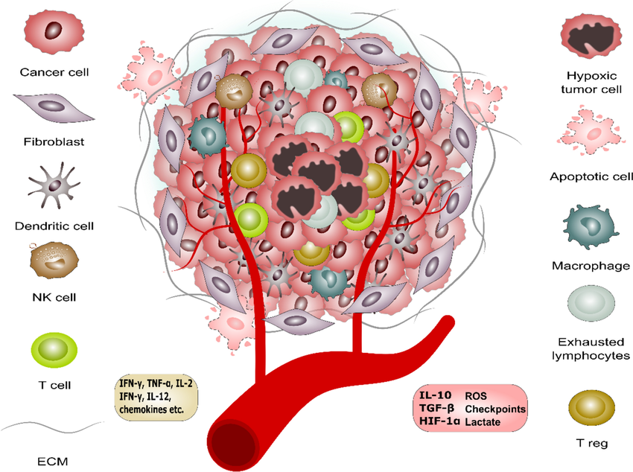
Cancer doesn’t grow alone, it collaborates.
scRNA-seq lets us eavesdrop on the tumour microenvironment, revealing cancer, immune, and stromal cells cross-talk influencing resistance.
Singh, Ranjeet & Srivastava, Prateek & Manna, Partha. (2024). Evaluation of regulatory T-cells in cancer immunotherapy: therapeutic relevance of immune checkpoint inhibition. Medical Oncology. 41. 59. 10.1007/s12032-023-02289-y.

Slide 5
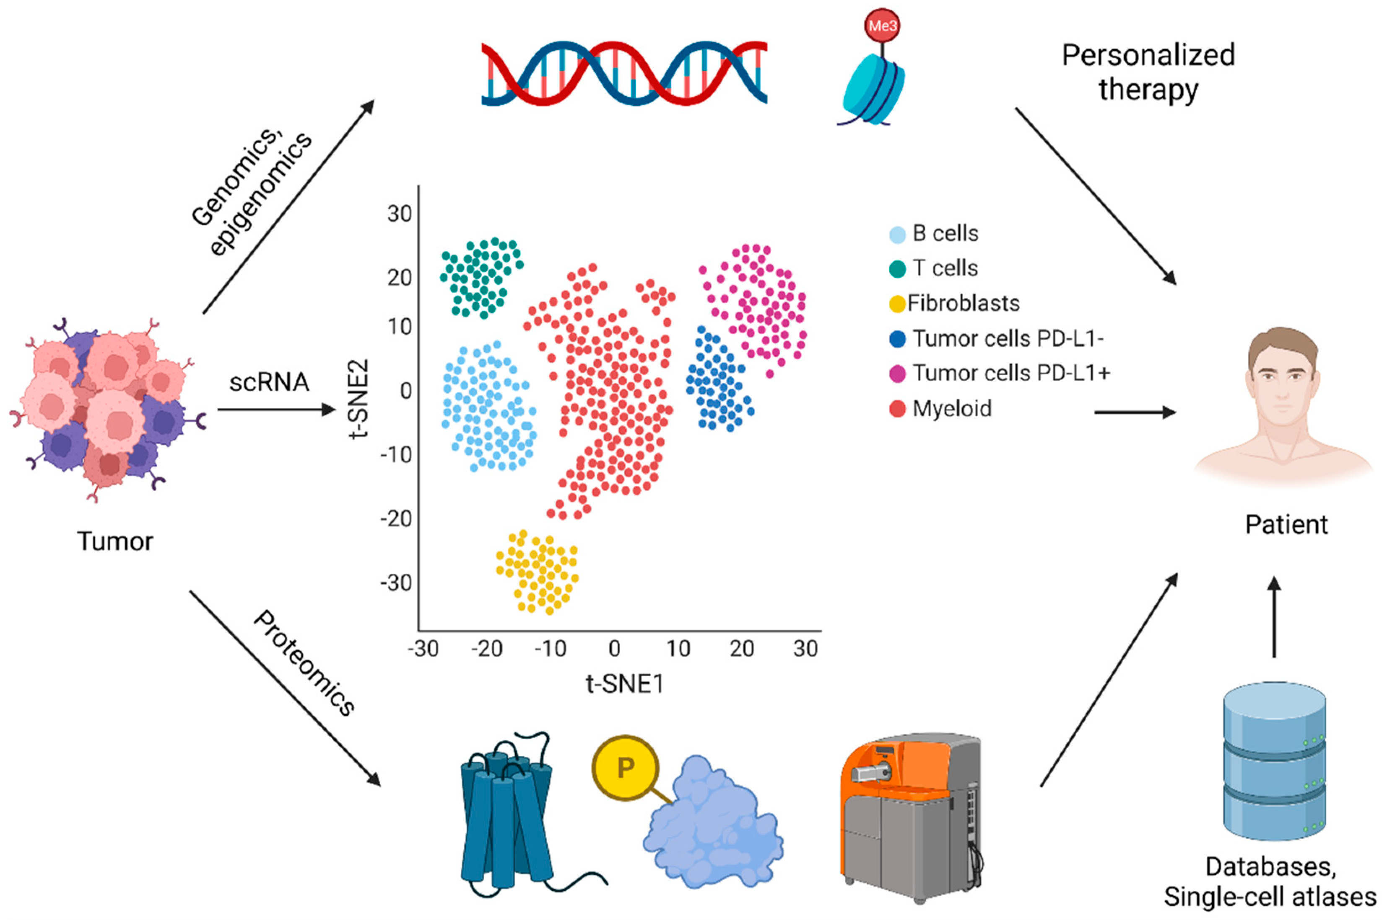
Translating Single-Cell Insights to the Clinic
Single-cell data aids biomarker discovery, patient stratification, and drug design.
AI-driven models simulate treatment responses, making precision medicine predictive. scRNA-seq bridges basic discovery and real-world clinical application.
Mustachio, L. M., & Roszik, J. (2022). Single-Cell Sequencing: Current Applications in Precision Onco-Genomics and Cancer Therapeutics. Cancers, 14(3), 657. https://doi.org/10.3390/cancers14030657

Slide 6
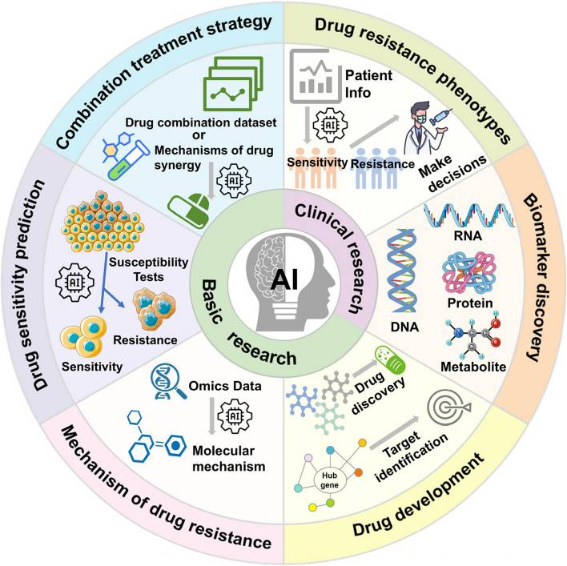

This data helps researchers design targeted therapies, identify resistant cells, and guide precision oncology , treatments that evolve as fast as the cancer does.
Mao Y, Shangguan D, Huang Q, Xiao L, Cao D, Zhou H, Wang YK. Emerging artificial intelligence-driven precision therapies in tumor drug resistance: recent advances, opportunities, and challenges. Mol Cancer. 2025 Apr 23;24(1):123. doi: 10.1186/s12943-025-02321-x. PMID: 40269930; PMCID: PMC12016295.

